Slide 1
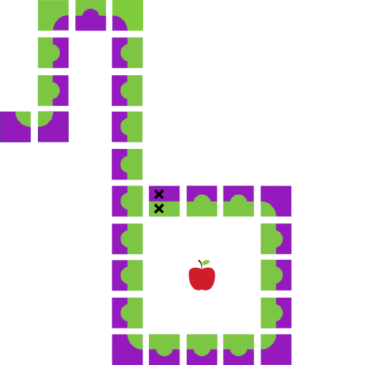
Java Workshop 3
Aadila Ali Sabry

Slide 2
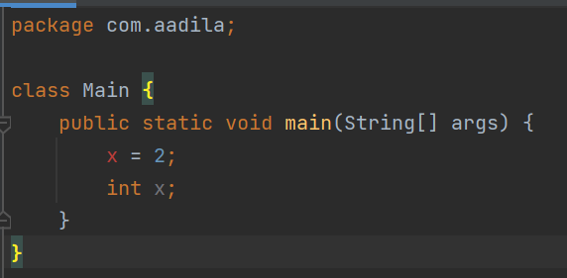

Slide 3
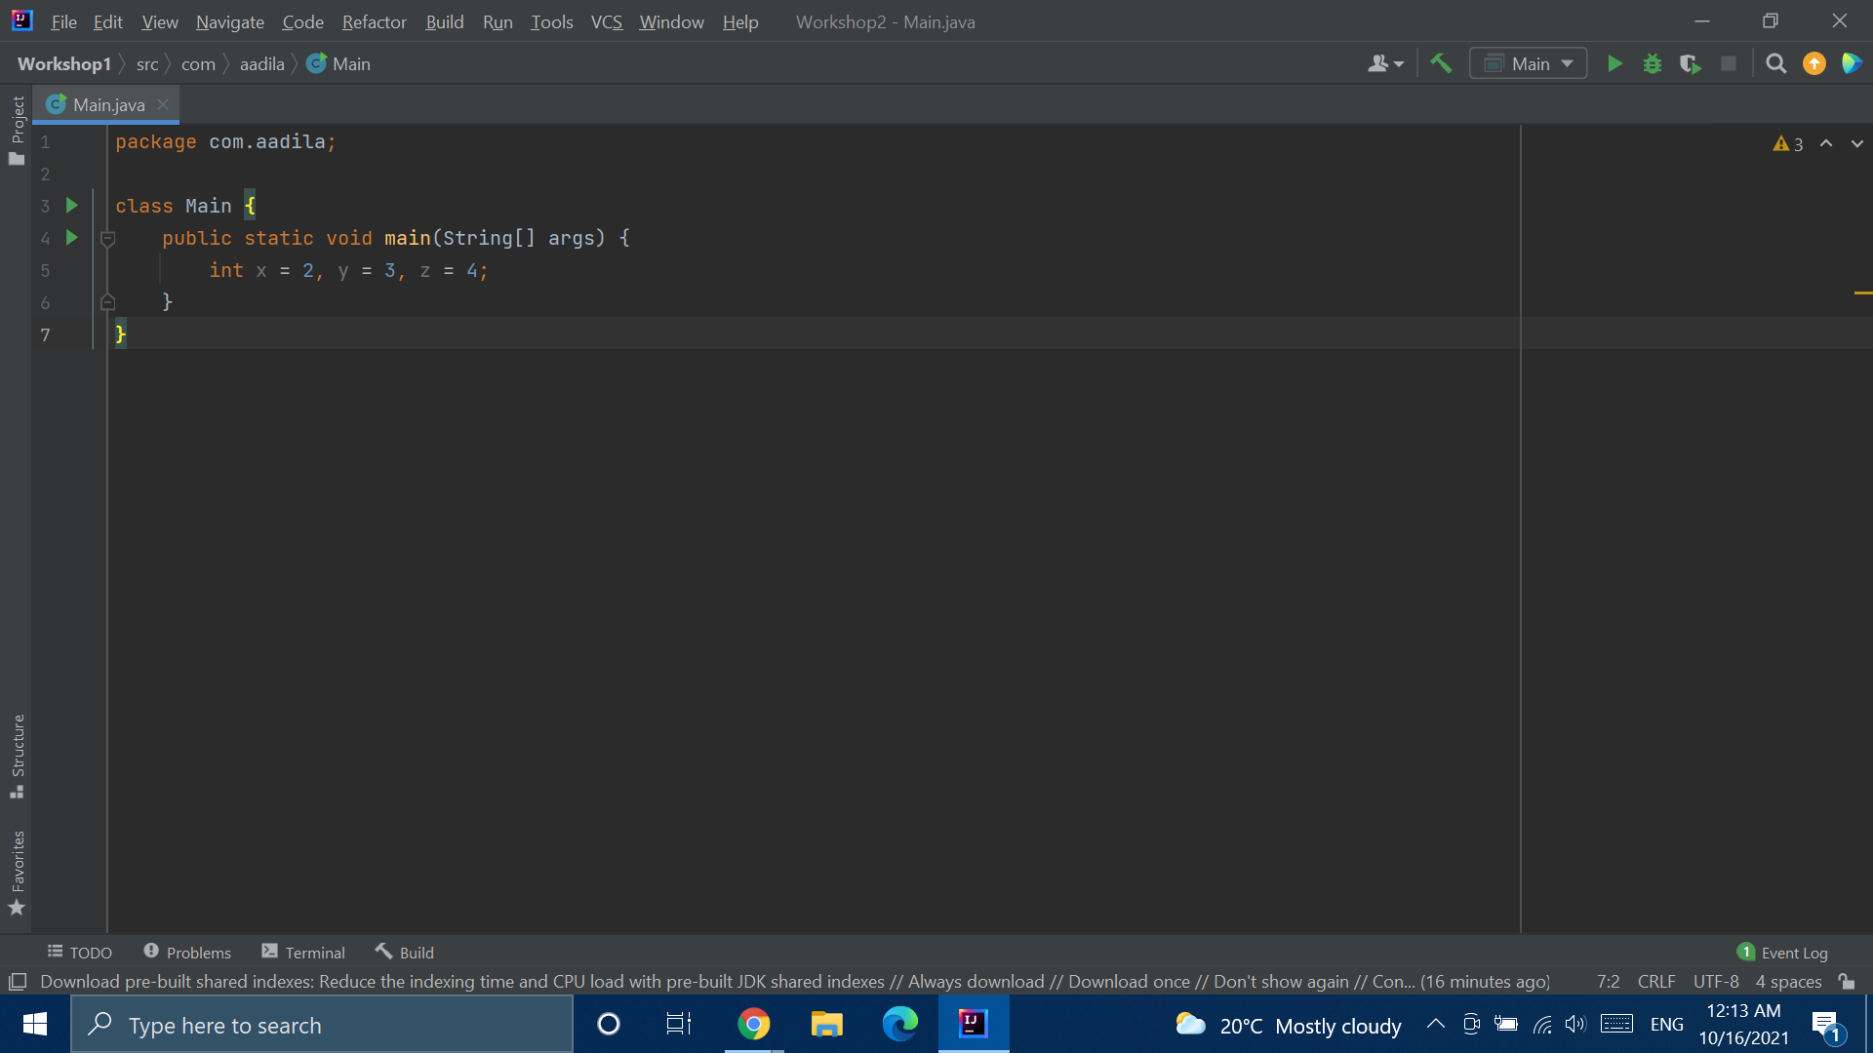
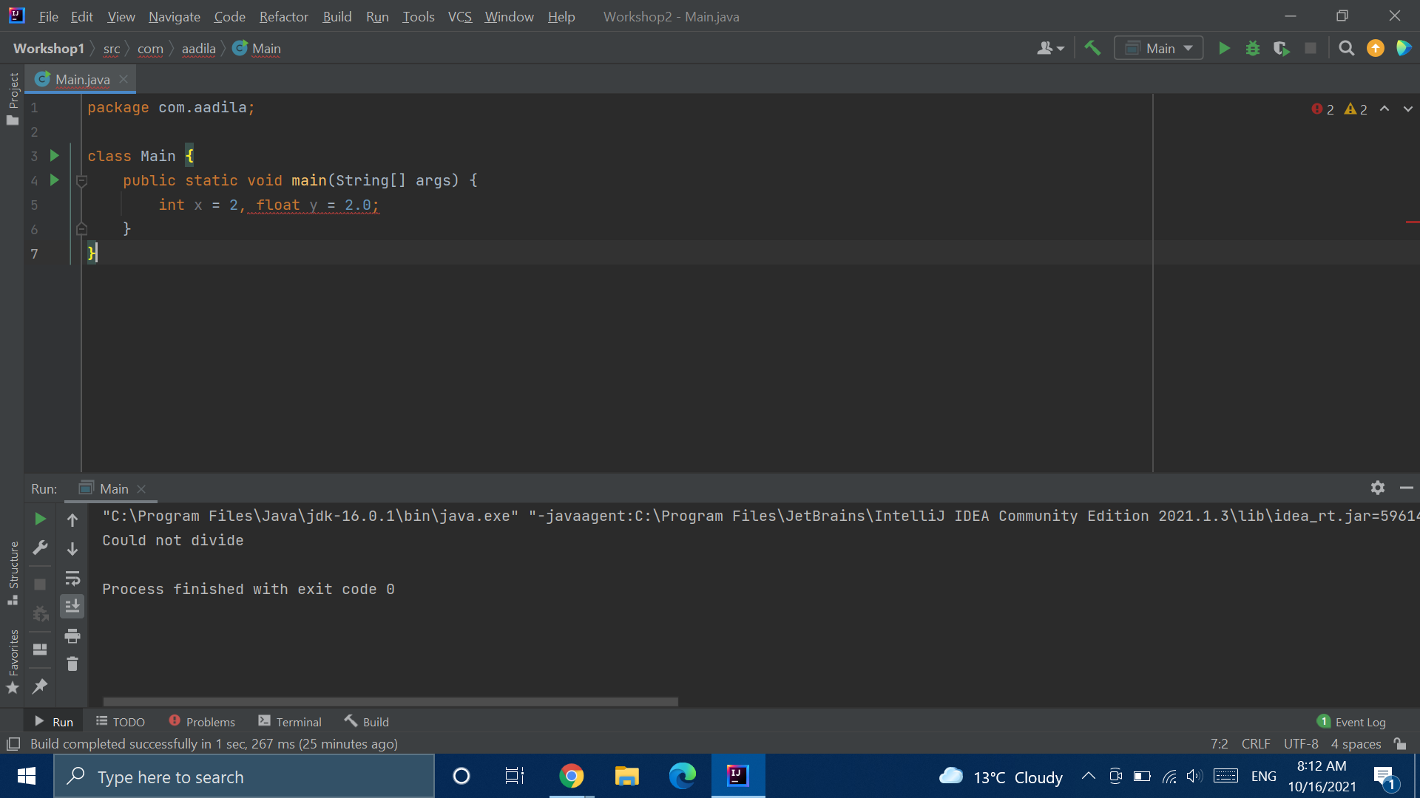

Slide 4
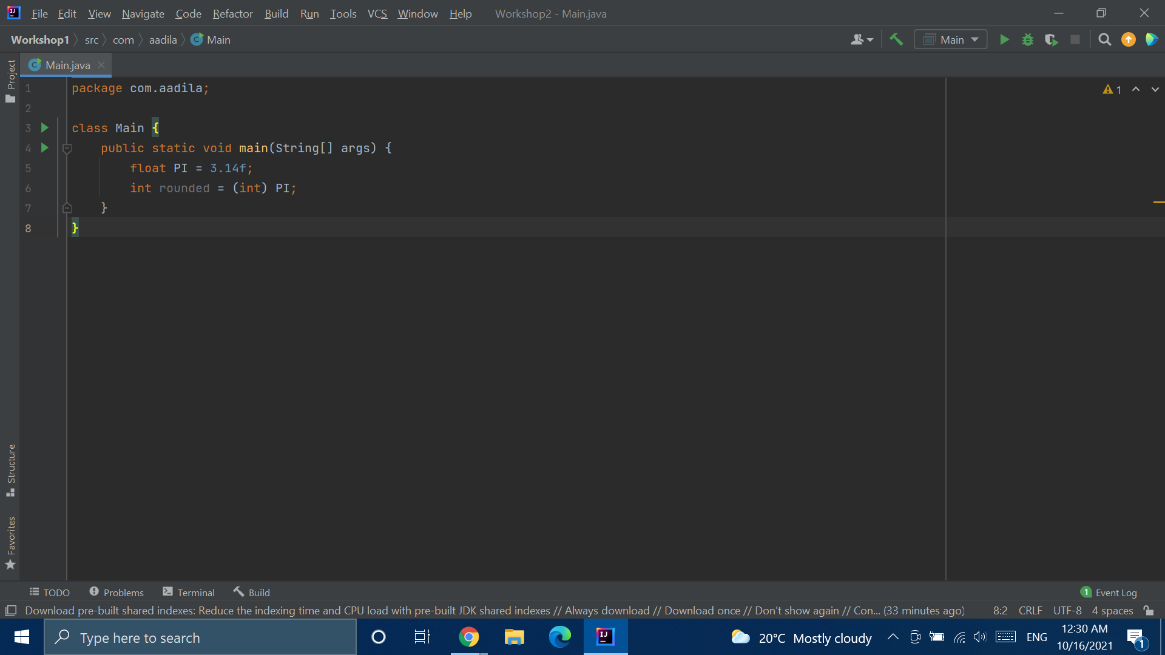
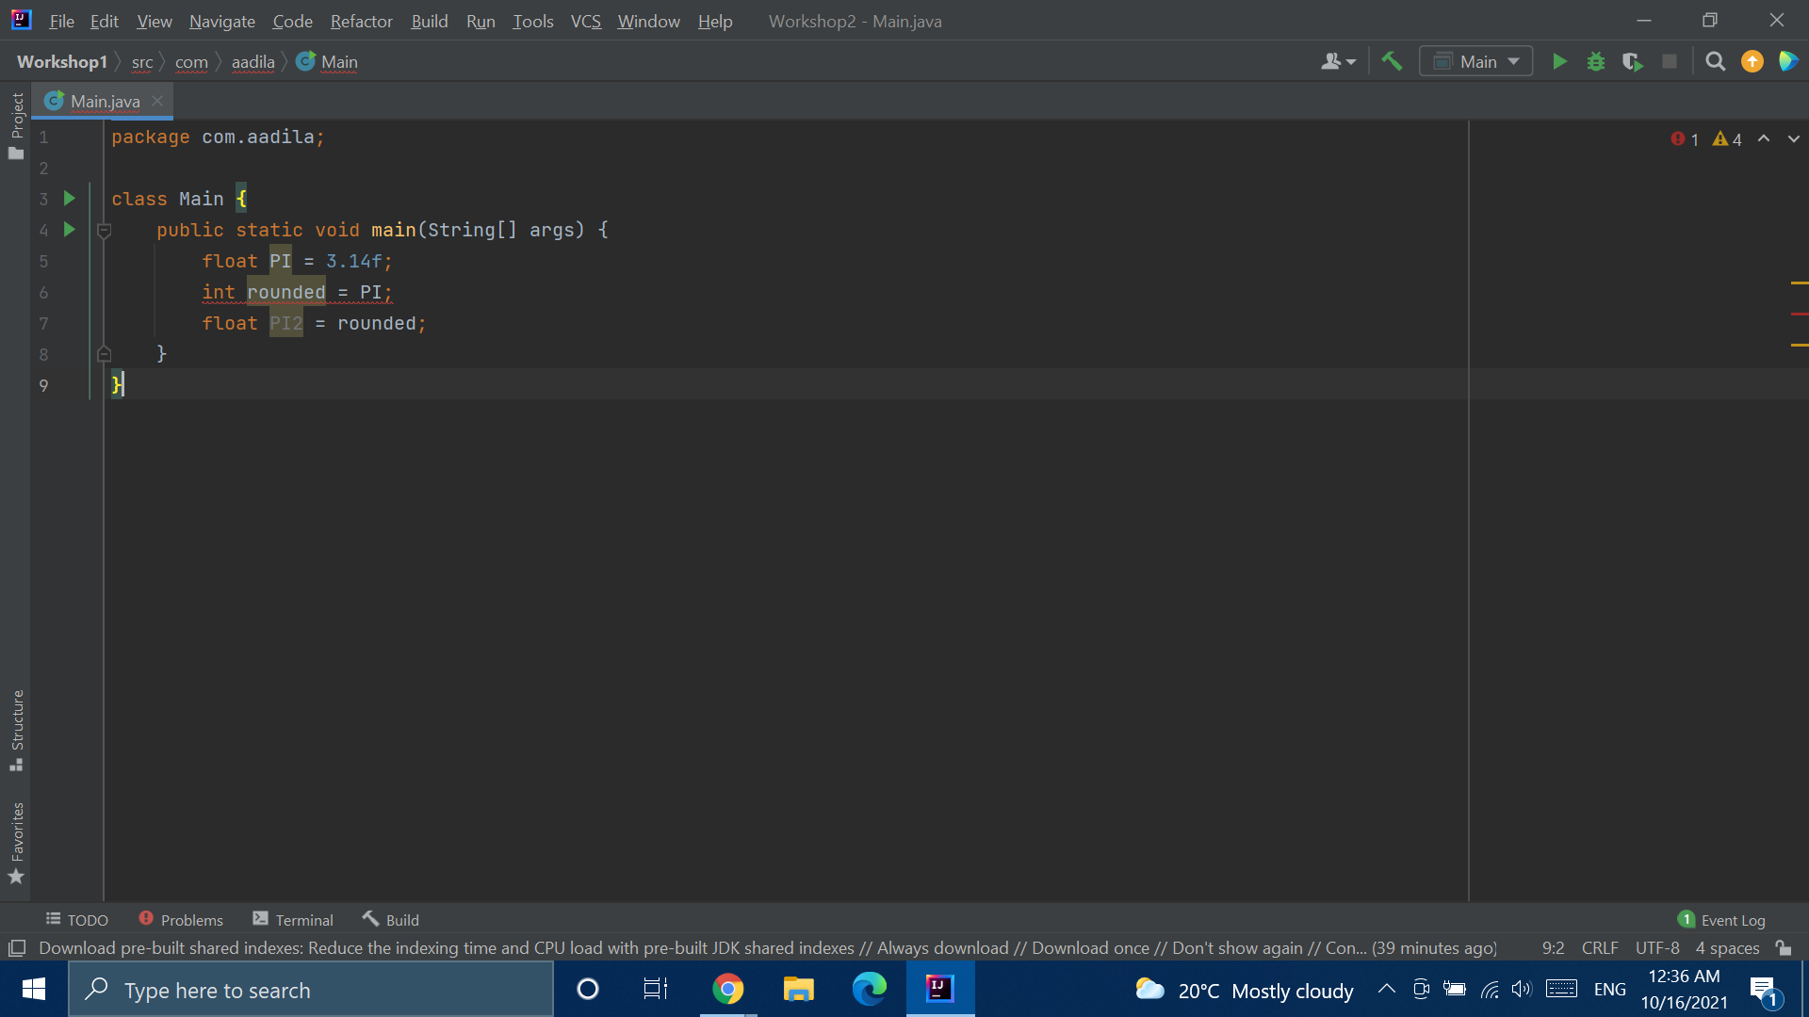
Type Casting

Slide 5
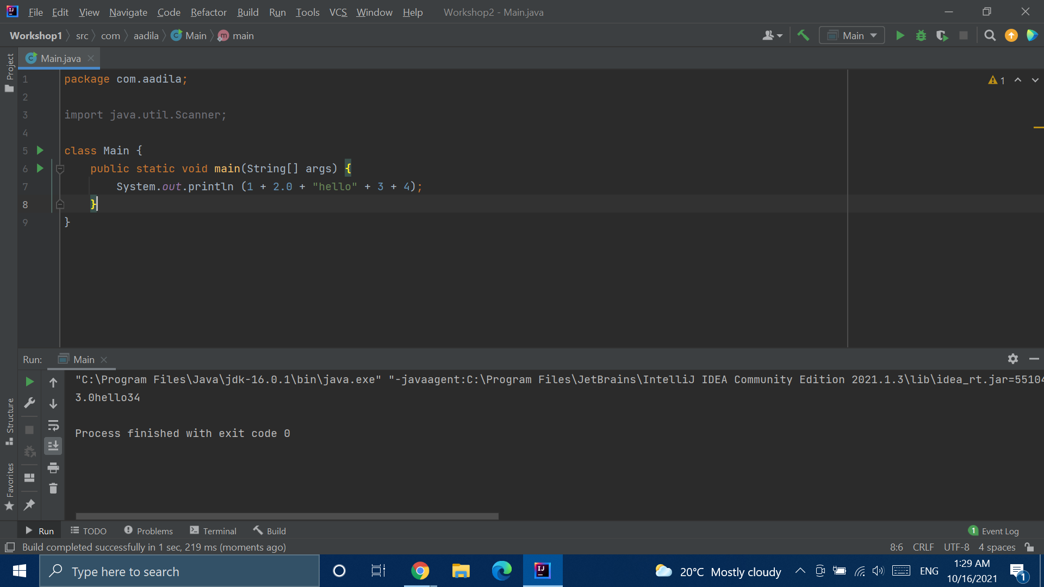

Slide 6
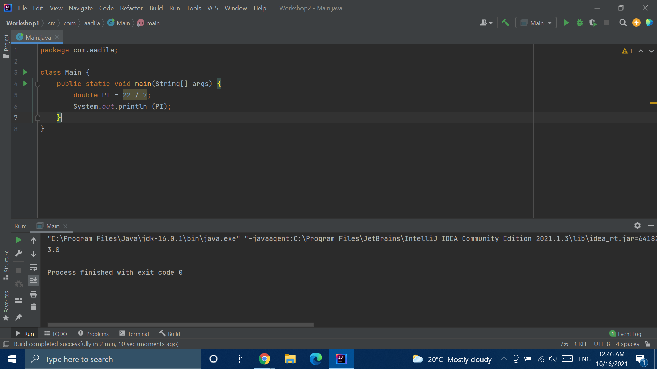


Slide 7
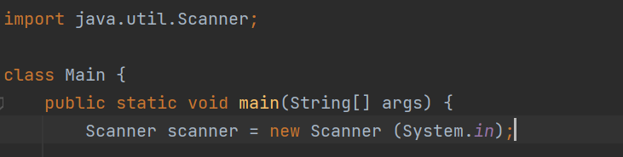
Taking Input
Import statement
Scanner variable declaration

Slide 8
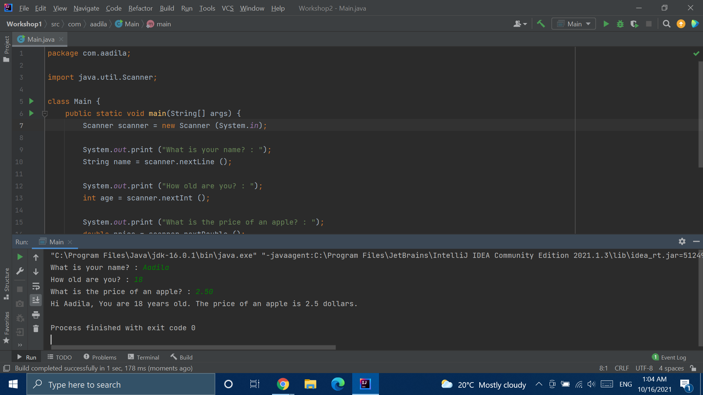

Slide 9
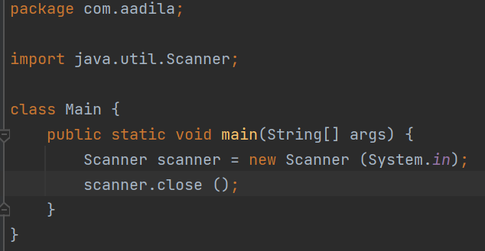
Working with Scanners

Slide 10
Naming Conventions
camelCase
FOR METHODS AND VARIABLES
PascalCase
FOR CLASSES AND INTERFACES
CONST_VAR
FOR CONSTANT VARIABLES
Notes:
https://www.oracle.com/java/technologies/javase/codeconventions-namingconventions.html

Slide 11
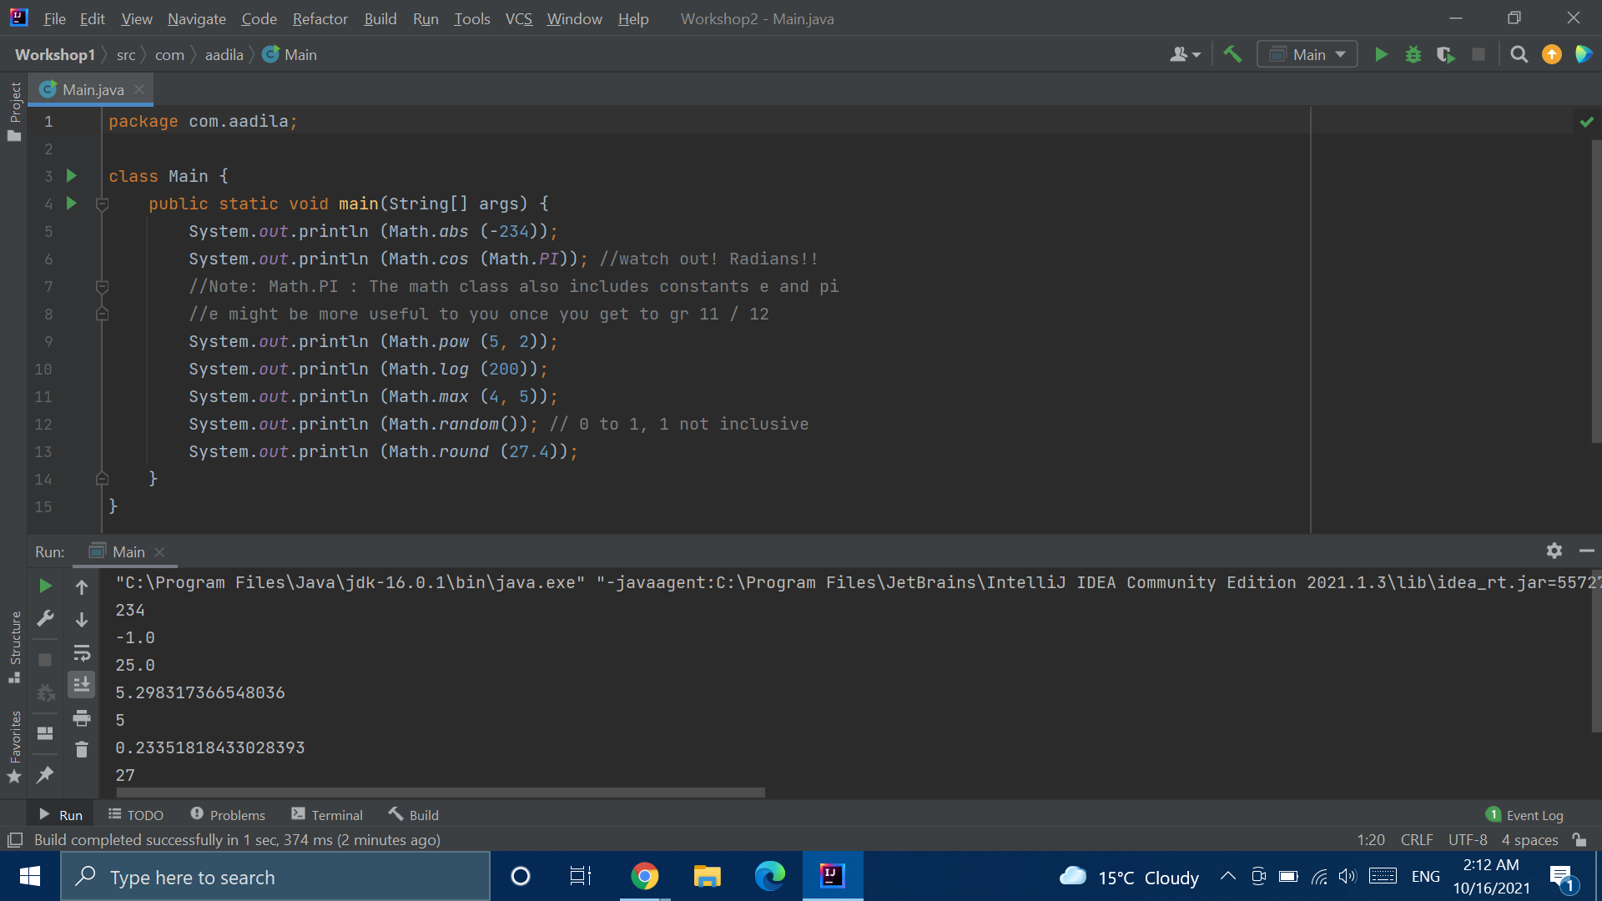
Math Class Methods

Slide 12
Random Number Generator
Notes:
https://replit.com/@AadilaAliSabry/Random-Number#Main.java

Slide 13
Round to Two Decimal Places
Notes:
https://replit.com/@AadilaAliSabry/Round-to-Two-Decimal-Places#Main.java

Slide 14
Break Time

Slide 15
Comparison Operators
What if:
I want to check whether you’re AT LEAST 18 before I let you vote?
I want to see whether you’re eligible for a prize as the hundredth person to walk through my store?
I want to make sure my denominator does NOT EQUAL 0 before trying to divide by it
boolean canVote = (age >= 18);
boolean isHundredth = (customers == 100);
Boolean validDenom = (denom != 0)

Slide 16
Comparison Operators
Operator | Meaning
== | Equal to
!= | Not equal
> | Greater than
< | Less than
>= | Greater than or equal to
<= | Less than or equal to
Notes:
https://www.w3schools.com/java/java_operators.asp

Slide 17


Slide 18
Logical Operators
What if:
I want to check whether you’re at least 18 AND that you are a permanent citizen before I let you vote?
I want your parent’s permission for a field trip OR to know that you are 18
I want to make sure you do NOT have COVID before I let you enter my house?
boolean canVote = (age >= 18 && isCitizen);
boolean canTravel = (hasPermission || age >= 18);
boolean canInviteInside = (!isSick);

Slide 19
Logical Operators
Operator | Meaning
&& | Logical AND
|| | Logical OR
! | Logical NOT

Slide 20
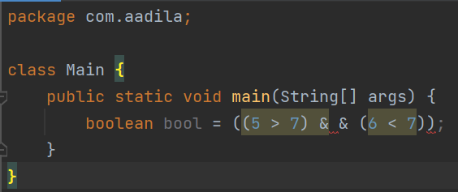

Slide 21
Truth Table - AND
A | B | A && B
True | True
True | False
False | True
False | False
True
False
False
False

Slide 22
Truth Table - OR
A | B | A || B
True | True
True | False
False | True
False | False
True
True
True
False

Slide 23
Truth Table - NOT
A | !A
True
False
False
True

Slide 24
Writing Logical Statements
Notes:
https://replit.com/@AadilaAliSabry/The-Handy-Dandy-Food-Server#Food%20Server.txt

Slide 25
if Statements
Your if statement goes at the beginning, and you can have only one of them for one if block. Your if statement MUST have a boolean expression.
If (boolean expression 1) {
statement (s) ;
} else if (boolean expression 2) {
Different statement (s) ;
} ….
else {
Default statement (s) ;
}
You can have any number of else if statements, even 0. The rules are: they must come before the else statement, and after the if statement. Every else if must have a boolean expression.
Your else statement goes at the end, and it is optional. You may only have one else statement if you have one at all, and it has no boolean expression. Put the default code, ie. the code to execute if none of the conditions hold, here.

Slide 26
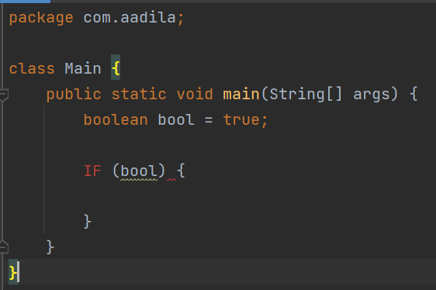

Slide 27
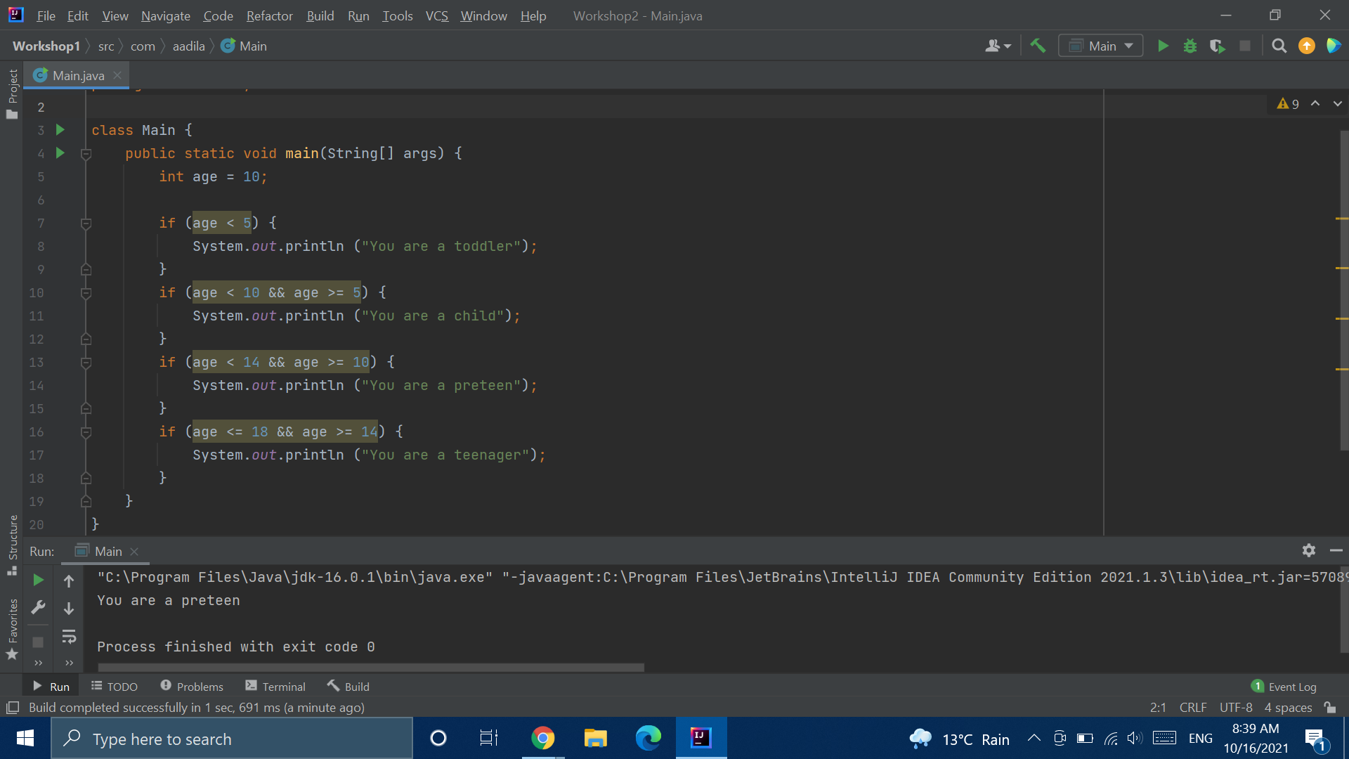

Slide 28
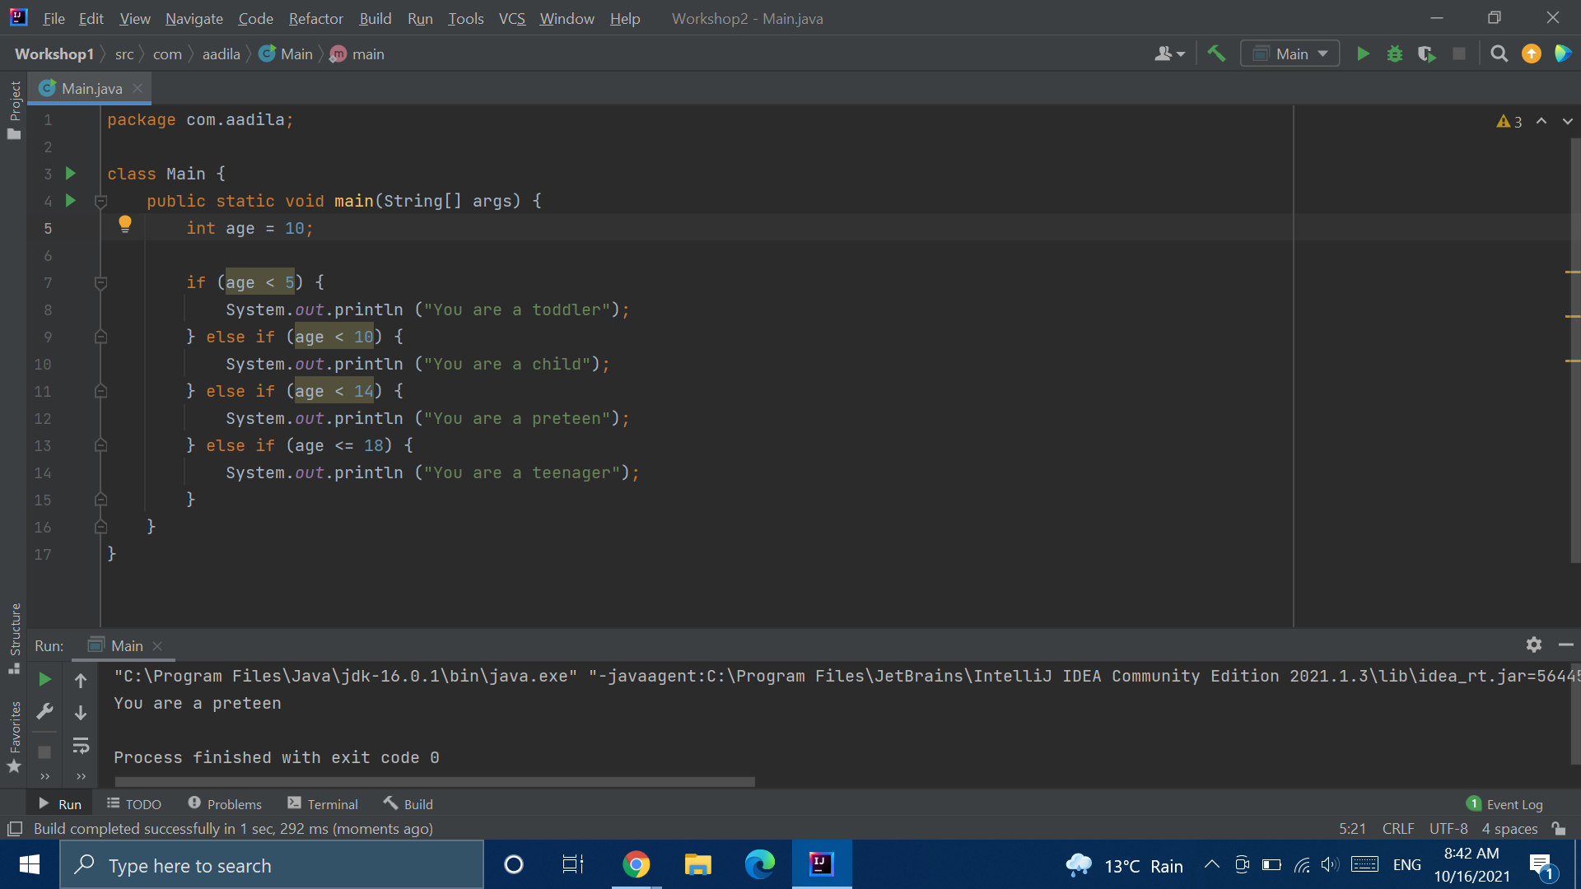

Slide 29
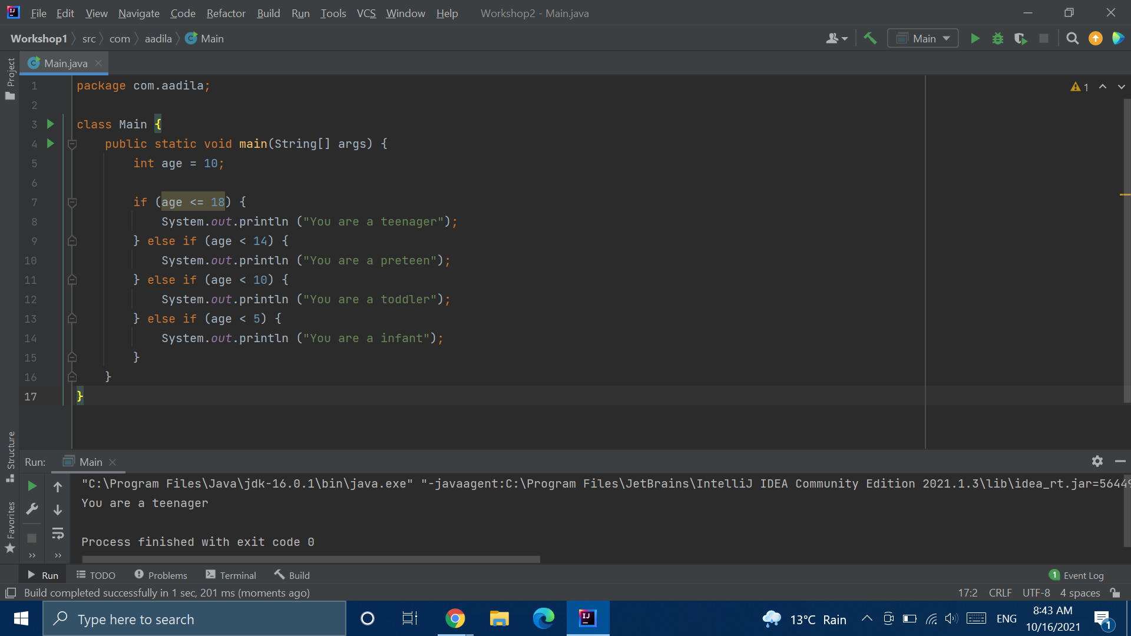
Notes:
https://replit.com/@AadilaAliSabry/Working-with-if-Statements#Main.java

Slide 30
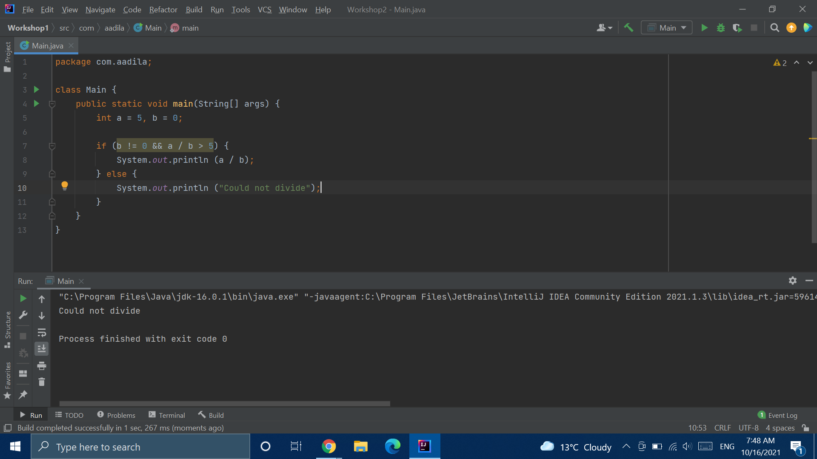

Slide 31
for Statements
for (statement 1; boolean expression; statement 2)
Statement 1 is executed once at the beginning of the for loop
The boolean expression is evaluated before each time it loops. The for loop will stop once the boolean expression is false
Statement 3 is executed at the end of each loop

Slide 32


Slide 33
Prime factorization
Notes:
https://www.mathsisfun.com/prime-factorization.html

